Slide 1
International Line Iceberg Display
Product Owner Reference
Mr. Cline
US Coast Guard Research and Development Center
Revised 10/18/2018

Slide 2
Team Members
Owner – Mr. Cline
Advisor – Dr. Mraz
Subject Matter Expert – Dr. Kessler
Subject Matter Expert – Mr. Gold
2/c Christopher Rosselot
2/c Luke Arsenault
2/c Hayden Carter
2/c Maylis Yepez
2/c Thomas Hardy

Slide 3
Product Elevator Pitch Statement
L.I.D takes daily information transmitted from the NAIS (North American Ice Service), converts LAT/LONG position of iceberg risk boundaries into a usable format of contour lines which then will be sent out to mariners to be plotted on commercial navigation equipment.

Slide 4
Product Vision Board
Target Customer | Needs | Product | Value
Mr. Cline | Validation of output | The code to run the software | Continual development of software to support the missions of IIP
Public Mariners | Save time and feel safe when navigating by icebergs | Software compatible with AIS/Nav system | Keep local mariners safe, and substantial time saving
NAIS | Quick dissemination of information from NAIS | Software that’s ready to publish new data daily | Fewer errors with conversion of daily information

Slide 5
Customer Persona
Profile | Goals | Persona Name
ORCA at CG RnD Center | Demonstrate Practicality | Calvin
Mariners traversing the North Atlantic | Have program to keep them safe | Captain Hook
Organization of people disseminating information on icebergs | Have a software to invert text file into mappable data | Big Brother

Slide 6
Impact Mapping
Goal | Actor | Impact | Deliverable
Intaking daily risk contours, converting to AIS payload | Big Brother | Progress in an ongoing project and success in the subproject | Working Program
 | Calvin |  | Software with mappable data
 | Captain Hook | Automated delivery of information, allowing better situational awareness of iceberg risk area | Display on true navigation systems domestic and international
 | Capitaine Hook
 | CAPT Vann |  | Display on Portable Device (Laptop)
 | Iceberg Chasers |  | Display on internet
 | Risk Takers | Informed decisions made for risk taking | Density of icebergs within a specific region
 | Casual File Uploaders | Ability to use data in commercial systems (google earth) | File Conversion to kml
 | Climate Change Enthusiasts | Access to information to bolster research/arguments | Historical data, trends, moving graph, access from internet, display on navigation systems and portable devices
 | Polar Research Fleet

Slide 7
Activity Diagram
IIS
NAIS
LID
CAPT Hook
Capitaine Hook
Calvin
Research
Broadcast
Lat/Long
Daily Iceberg Bulletin
Parser
Bearing/
Distance
AIS msg payload format
Encap. Payload to AIS
Structure Data
Data
Bearing/Dist. Data
Receive
TV-32 Display
Validate
Lat/Long
TV-32 Display
Compare Bulletin
KML
Google
Time Series

Slide 8
Activity Diagram – Sprint 1
IIS
NAIS
LID
CAPT Hook
Capitaine Hook
Calvin
Research
Broadcast
Lat/Long
Daily Iceberg Bulletin
Parser
Bearing/
Distance
AIS msg payload format
Encap. Payload to AIS
Structure Data
Data
Bearing/Dist. Data
Receive
TV-32 Display
Validate
Lat/Long
TV-32 Display
Compare Bulletin
KML
Google
Google Earth Display
Time Series
Initial Sprint Efforts to demonstrate ingesting data and producing intermediate decimal data for Bearing/Distance calculations.

Slide 9
Sprint 1
Date: 30OCT19 Sprint: 1-2 Team: LID
 | Task | Priority | Est Time | Assigned | Actual Time | Percent Complete
1 | Create our own Bulletin | 5 | 1 | Maylis Yepez | 1 | 100
2 | Use Google Earth to Load A KML file | 7 | 2 | Hayden Carter | 2 | 100
3 | Bulletin Acquisition | 7 | 3 | Christopher Rosselot | 3 | 100
4 | Data Parser | 10 | 4 | Tom Hardy | 6 | 100
5 | KML File Creation | 8 | 4 | Hayden Carter | 5 | 100
6 | Distance/Bearing Research | 6 | 3 | Maylis Yepez | 3 | 80
7 | GitHub Operational | 9 | 2 | Chris Rosselot | 2 | 100
8 | Tv-32 Research | 7 | 3 | Luke Arsenault | 3 | 80
9 | Integration between 3 classes | 10 | 2 | Tom Hardy, Chris Rosselot | 2 | 100
10 | Backup KML File | 4 | 2 | Luke Arsenault | 3 | 100
Tasks performed to provide Google Earth representation of Iceberg Risk limits.

Slide 10
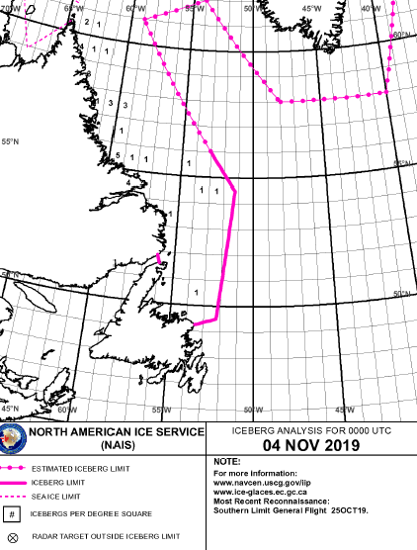
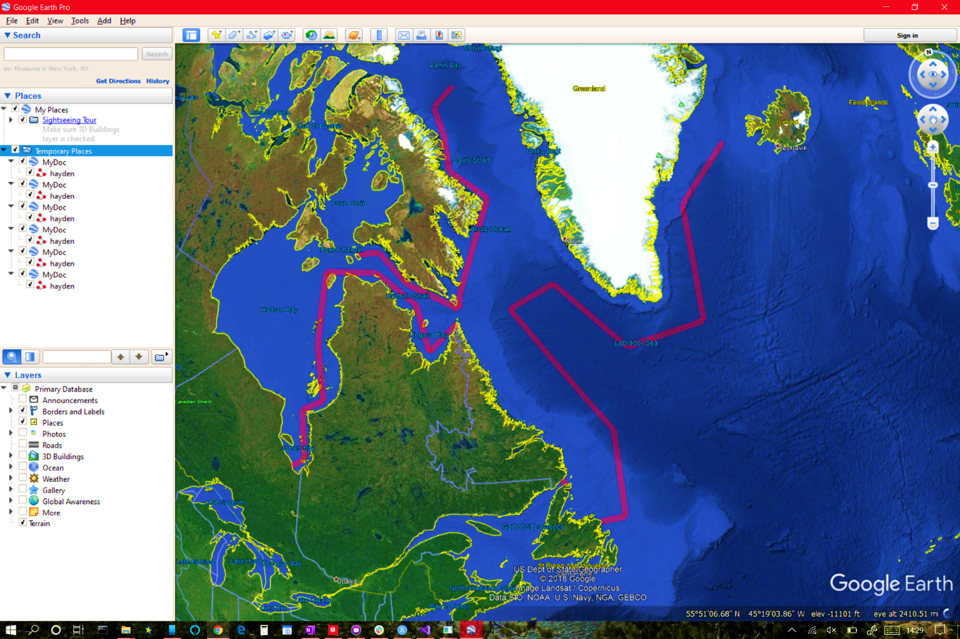
Sprint 1
Bulletin Image of NAIS website
Transformation to Google Earth
Visual Validation of transformation of coordinates to Google Earth KLM.
Notes:
Demonstration of line segment generation. Custom dashed line segments are to be added later.

Slide 11
Sprint 1
<?xml version="1.0" encoding="utf-8"?>
<kml xmlns="http://www.opengis.net/kml/2.2">
<Document id="null">
<name>MyDoc</name>
<open>true</open>
<Style id="thisusedtobelongname">
<LineStyle>
<color>501400fa</color>
<width>10</width>
</LineStyle>
<PolyStyle>
<color>501400fa</color>
</PolyStyle>
</Style>
<Placemark>
<name>hayden</name>
<visibility>false</visibility>
<styleUrl>#thisusedtobelongname</styleUrl>
<LineString>
<extrude>true</extrude>
<tessellate>true</tessellate>
<altitudeMode>clampToGround</altitudeMode>
<coordinates>-53.5,49.25
-51.5,49.25
-51,54
-53,56</coordinates>
</LineString>
</Placemark>
</Document>
</kml>
LATEST ICEBERG BULLETIN
1. NORTH AMERICAN ICE SERVICE (NAIS)
ICEBERG BULLETIN 050001Z NOV.
2. ICEBERG LIMIT ALONG TRACKLINE JOINING
49-15N 053-30W, 49-15N 051-30W,
54-00N 051-00W, 56-00N 053-00W.
3. ESTIMATED ICEBERG LIMIT ALONG
TRACKLINE JOINING
56-00N 053-00W, 61-00N 059-00W,
62-00N 054-00W, 58-00N 048-00W,
58-00N 040-00W, 64-00N 037-00W,
66-00N 028-00W.
4. WESTERN ICEBERG LIMIT ALONG TRACKLINE
JOINING
51-52N 056-05W, 51-34N 055-55W.
5. SEA ICE LIMIT ALONG TRACKLINES
JOINING:
A. 63-40N 077-00W, 63-55N 074-25W,
62-25N 070-35W, 61-10N 064-30W,
62-00N 064-20W.
B. 60-25N 064-45W, 58-55N 067-35W,
61-20N 069-15W, 62-50N 074-15W,
62-25N 080-35W, 58-30N 079-45W,
55-35N 078-10W, 54-50N 080-15W,
52-10N 079-20W, 51-30N 080-30W.
C. 62-00N 064-20W, 66-55N 060-40W,
68-30N 066-05W, 70-25N 067-10W,
72-10N 069-35W, 73-25N 066-25W.
…
9. CANCEL THIS MSG 060001Z NOV 19.
49.25,-53.5 49.25,-51.5 54,-51 56,-53 56,-53 61,-59 62,-54 58,-48 58,-40 64,-37 66,-28 51.866666,-56.083333 51.566666,-55.916666 63.666666,-77 63.916666,-74.416666 62.416666,-70.583333 61.166666,-64.5 62,-64.333333 60.416666,-64.75 58.916666,-67.583333 61.333333,-69.25 62.833333,-74.25 62.416666,-80.583333 58.5,-79.75 55.583333,-78.166666 54.833333,-80.25 52.166666,-79.333333 51.5,-80.5 62,-64.333333 66.916666,-60.666666 68.5,-66.083333 70.416666,-67.166666 72.166666,-69.583333 73.416666,-66.416666
Google Earth KML Line Segment Representation
Original Iceberg Data
Lat – Long format
Transform to Decimal Coordinates

Slide 12
Sprint 2

